Slide 1

Managing Microsoft Azure Stack Hub
Microsoft Azure Stack Hub Control Plane Monitoring
This work is licensed under a Creative Commons Attribution - ShareAlike 4.0 International Public License

Slide 2
Agenda
Azure Stack Hub Admin philosophy
Management and monitoring basics
Monitoring Azure Stack Hub
Alert remediation
Capacity
Azure Monitor on Azure Stack Hub
Integrating with Existing Tools
Infrastructure integration
SCOM, Nagios, other tools

Slide 3
Basics of Azure Stack Hub Management and Monitoring: Azure Stack Hub Components

Slide 4
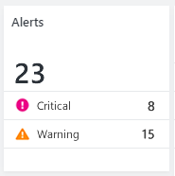
Azure Stack Hub monitoring
Azure Stack Hub Instance
Hardware Lifecycle Host VM (HLH)
OEM Network Switches
Azure Stack Hub software components internally monitored via
Health Services
Service Fabric Health
Metrics and Logs centrally collected
Hardware monitoring
OEMs responsible for agentless HW device monitoring/validation through external systems (monitor nodes/switches)
This is done by each OEM adding a VM to Azure Stack Hub called the Hardware Lifecycle Host
S2D storage monitored by Azure Stack Hub components
REST API for 3rd party integration of alerts, metrics, and logs
SCOM Azure Stack Hub Fabric MP
Nagios integration
Azure Stack Hub Software Components Health & Alerts visible in Admin Portal
Alerts generated from:
Internal Health Services
WSHS
Service Fabric
Azure Stack Hub components
Rest API available for 3rd Party System Integration
Monitoring via SNMP
External Monitoring Systems
Restful
Integration
Agentless device Monitoring
OEM HW Nodes

Slide 5
Infrastructure Resource Providers overview
Fabric, health, and updates: FRP – HRP – URP
Enable communication with the underlying infrastructure Roles and Hardware Layer
Microservices running in the Infrastructure Service Ring
Can only be called with the Admin Subscription
Each RP provides a northbound API REST API
Consumed by UX – Portal, PowerShell, Visual Studio, and other tools
Each RP uses a southbound API to communicate with Controllers
HRP and URP provide registration interface for ARM deployable RPs
ARM LAYER
Azure Portal (UX)
Templates/PowerShell/CLI, SDK, etc.
Azure Resource Manager (ARM)
RP LAYER
PARTITION REQUEST BROKER
FRP
HRP
URP

Slide 6
Hardware management diagram
Out of Band Health Monitoring – Agent less using
external monitoring entity such as System Center Operations Manager or Nagios
Portal/UX
Infrastructure Role
Network Switch
Radius
ARM
As an admin, you use Portal/ARM/CLI to ask the Fabric Resource Provider to perform an action…
FRP
NRP
…
DS
Radius
And the action will be performed by the appropriate Azure Stack Hub service…
Physical Node Manager
Infra
Deployment
Network Controller
…
Power On
Power Off
Recycle Power
Change Boot Order – Clear / Get SEL logs
Can use external Radius
LDAP or Radius
Here are some example actions…
Hardware
Health
BMC (IPMI) *dedicated NIC
LDAP/Radius
Azure Stack Hub

Slide 7
Monitoring Azure Stack Hub

Slide 8

Monitoring problem space
Complexity of understanding health
Clouds depend on many different technologies
Health of the cloud is not the sum of its parts
How do alerts relate to health?
Tax of alert deciphering
Which alerts do I need to take action on?
Which alerts should I address first?
What are the steps to resolve?

Slide 9
Azure Stack Hub monitoring philosophy
Health is shown through ALERTS
The alerts are managed by the Health Resource Provider (HRP)
You can consume these alerts to suit your own tools and processes
Azure Stack Hub manages and monitors all of the software in the box
OEM will provide management capabilities for the hardware (including in-box network switches)
The Hardware Lifecycle Host VM, which is OEM-specific, hosts these hardware management roles (and can be the target location to store logs pulled from an Azure Stack Hub scale unit during troubleshooting)
Th

Slide 10
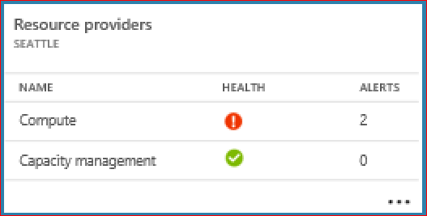
Monitoring and operation: Core principles
Azure Stack Hub is designed to be treated like an appliance
Majority of a cloud admin’s interaction with Azure Stack Hub should be driven by Alerts (if it’s not broken, don’t touch it)
Azure Stack Hub component health should be directly tied to Alerts
Alerts should be
Easy to understand impact and next steps
Resolved using common Azure Stack Hub Admin action patterns
Specific to Azure Stack Hub

Slide 11
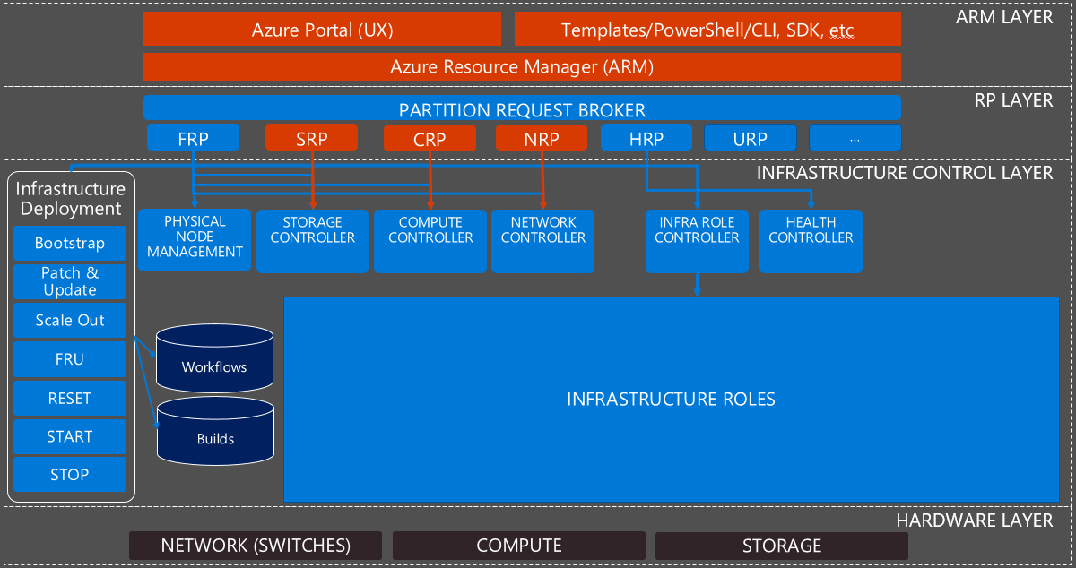
Azure Stack Hub infra, HW monitoring & integration overview
Azure Stack Hub alerts can be consumed by external monitoring solutions
HRP Rest API
Windows Server Health Service Alerts for:
Physical Disks
Network Adapters
Node
Network switches monitored via SNMP
External Monitoring Solution
Agentless monitoring of hyper-converged hardware using BMC. Solution dependent on hardware vendor.
Datacenter network

Slide 12
Alert and remediation examples
Alert name | Severity | Component | Alert remediation
An infrastructure role is unresponsive | Critical | Compute controller | Navigate to the compute controller infrastructure role and restart the role If the issue persists, contact support
Low memory capacity in Azure Stack Hub region | Warning | Capacity management | Add a node to the scale unit using the capacity management admin blade
A physical disk has failed | Warning | Capacity management | The physical disk located <Location Info> has failed. The process of repairing the storage virtual disk has been initiated. It is important to replace the physical disk to ensure full capacity and resiliency. Click on this to learn more about performing the disk replacement procedure.

Slide 13
Azure Monitor on Azure Stack Hub

Slide 14
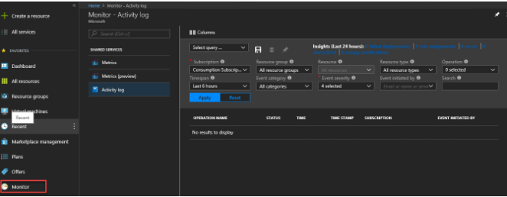
Azure Monitor for Azure Stack Hub
Azure Monitor is the platform service that provides a single source for monitoring Azure resources. With Azure Monitor, you can visualize, query, route, archive, and otherwise take action on the metrics and logs coming from resources in Azure Stack Hub with experiences consistent with Azure. You can work with this data by using the Azure Stack Hub admin portal, Monitor PowerShell Cmdlets, Cross-Platform CLI, or Azure Monitor REST APIs
Azure Monitor on Azure Stack Hub provides metrics for the compute and storage services, with additional services to be added in the future

Slide 15
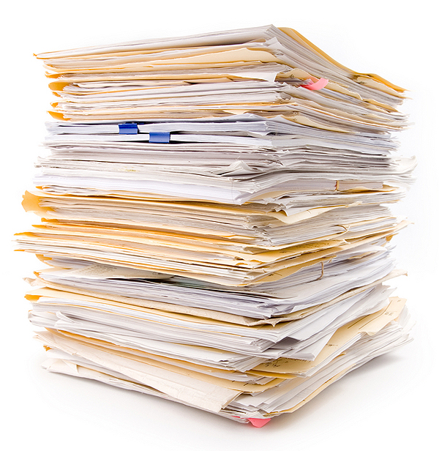
Application - Diagnostics logs, Application logs, and Metrics
Applications can run in the OS of a VM running with the Microsoft.Compute resource provider. These applications and VMs emit their own set of logs and metrics. Azure Monitor relies on the Azure diagnostics extension (Windows or Linux) to collect most application level metrics and logs
The types of measures include:
Performance counters
Application logs
Windows event logs
.NET event source
IIS logs
Manifest-based ETW
Crash dumps
Customer error logs

Slide 16

Uses for monitoring data
Store and Archive
Some monitoring data is already stored and available in Azure Monitor for a set amount of time
Metrics are stored for 90 days
Activity log entries are stored for 90 days
Diagnostics logs are not stored
Archive the data to a storage account for longer retention (work in progress as of November 2018)
Query
You can use the Azure Monitor REST API, cross-platform Command-Line Interface (CLI) commands, PowerShell cmdlets, or the .NET SDK to access the data in the system or Azure storage

Slide 17
Uses for monitoring data
Visualization
Visualizing your monitoring data in graphics and charts helps you find trends quicker than looking through the data itself
A few visualization methods include:
Use the Azure Stack Hub user and admin portal
Route data to Microsoft Power BI
Route the data to a third-party visualization tool using either live streaming or by having the tool read from an archive in Azure storage

Slide 18
Methods of accessing Azure monitor on Azure Stack Hub
In general, you can manipulate data tracking, routing, and retrieval using one of the following methods. Not all methods are available for all actions or data types.
Azure Stack Hub Portal
PowerShell
Cross-platform Command Line Interface(CLI)
REST API
.NET SDK

Slide 19
How the Health Resource Provider Works

Slide 20
What is HRP?
Health Resource Provider
Resource provider that provides and allows actions on Azure Stack Hub Alerts
Resource provider that collects and displays metric data
Runs as a Service Fabric service in the ‘XRP’ VM
The HRP provides a list of Resource Providers and Infrastructure Roles to the portal UI that allows an administrator to assess the health of Azure Stack Hub elements.

Slide 21
Data flow overview
Raw data collected from hosts and VMs.
Faults
Metric data
Heartbeats
Telemetry events
Audit logs
Monitoring system accesses the RAW data to process:
Faults => Alerts
Metrics aggregation
Delete old data
Telemetry subsystem extracts telemetry events and sends them to Microsoft through normal telemetry interface (UTC)
Data is later analyzed at Microsoft to understand stamp behavior (telemetry sending can be disabled)
We upload all Alerts
Response to external component calls:
Alert list and details
Region Health
List of registered RPs and Resources
Admin Portal
4
1
2
3

Slide 22
Registration with monitoring
All foundational RPs are registered with HRP during deployment (or redeployment during patch and update)
Value-add RPs, like SQL/MySQL do not currently register with HRP, but that is the intention for future enhancement
Each registration provides:
RP Display Name
Storage Account dedicated to monitoring
Alert templates
Infra resources are also registered and linked to RP
The registration data is used to determine which RPs/resources are healthy and which require attention
Alert templates determine which alerts will be shown to the user
Each RP therefore defines its own alerts and declares them to the HRP

Slide 23
Alert Remediation for Azure Stack Hub Infrastructure

Slide 24
Infrastructure operations (Actions)
Principles:
Administrative actions driven by alerts
Resource action hierarchy – how actions are applied when recovering functionality
(Some scenarios may require Privileged Endpoint access)
Resources | Available Actions
Infrastructure Role Instance | Start, Shutdown, Restart
Scale Unit Node | Repair, Drain/Resume, Shutdown, Power Off, Power On

Slide 25
Infrastructure role instances
Example scenario: An Infrastructure Role Instance is unresponsive and its functionality needs to be restored.
Available Actions
Start
Shutdown
Restart*
*Restart is implemented as a logic that orchestrates
Shutdown (Guest OS using IC), Turn Off VM, Start VM
Fabric RP
Compute Controller
Hyper-V

Slide 26
Scale unit node – Part 1
Example scenario: A Scale Unit Node is not responsive and its functionality needs to be restored.
Available Actions
Drain/Resume
Power On/Off
Fabric RP
Compute Controller
Failover Clustering
Fabric RP
Compute Controller
Enterprise Cloud Engn
BMC
IPMI

Slide 27
Scale unit node – Part 2
Available Actions
Repair
The ECE splits the repair request into two parts – disk and compute
Provision from bare metal and add node to scale unit’s cluster
1
Fabric RP
Enterprise Cloud Engine
Compute Controller
Failover Clustering
2
Compute
Make Physical Server available as compute resource
Add storage to the Storage Pool
Supported Scenarios
Data Drives Healthy
Bad Data Drives
Not supported
Dirty Drives
Storage Controller
If the disks have data, keep it. If not, wipe and add to storage spaces…
Azure-Consistent Storage
Storage

Slide 28
FRU – Field Replacement Unit
Example scenario: Scale Unit Node does not respond because of a damaged motherboard.
Ability to use KVM Viewer
Alert
Enable Maintenance Mode (drain)
Turn On
Turn Off
OEM
Disable Maintenance Mode (resume)
Repair Node
Replace Part
Check alert resolved

Slide 29
What happens if I can’t use the actions?
Example scenarios: Portal, ARM, Fabric Resource Provider, Directory Service or Storage are offline?
This account is like the server recovery console account in Windows
PS only
JEA
GMSA Domain Admin Account
JEA
Service Provider
Machine
Privileged Endpoint
Infrastructure Role Instances
Service Provider
Create Diagnostic Package
Start Unlock Process
Receives 2nd Phase Key from Support
Drives all input activity
Microsoft Support
Receives Diagnostic Package
Provides 2nd Phase for Two Way Factor Authentication
Shadows Azure Stack Hub troubleshooting ( Screen Sharing)
Guides Service Provider

Slide 30
Capacity Management

Slide 31
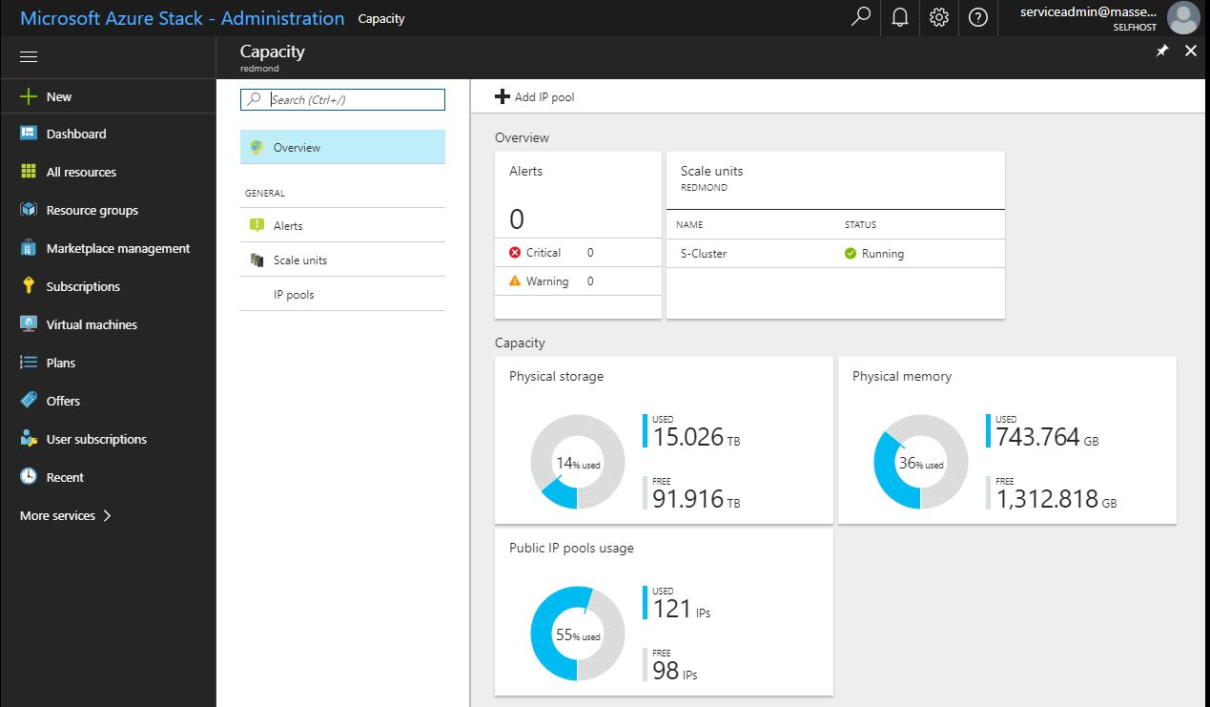
Basic – View/manage capacity using the portal
Goals
Retrieve Alerts for resources running low on capacity
Visualize resource usage (Memory, Storage, IP pools)
Add resources (for example, IP address space)
More advanced
Use alerts and metrics to feed an external tool for capacity management and planning

Slide 32
IP pools
Example scenario: I am running out of IP space for my external VIPs.
Available Actions
Get-AZsIpPool – List IP pools
Add-AZsIpPool - Adds IP pool
No size restrictions for expansion
Only deployment has an initial size requirement (based on VIPs)
Example:
Add-AzsIpPool -Name "PoolName" -StartIPAddress "192.168.55.1" -EndIPAddress "192.168.55.254" -AddressPrefix "192.168.55.0/24"
FRP
NC

Slide 33

Decision conversation – Connecting outside Azure Stack Hub
For your initial deployment, can you use alerts, health, and capacity information as exposed in the Azure Stack Hub portal, or do you need to connect to external monitoring/capacity/ticketing systems?

Slide 34
How to Talk to Azure Stack Hub

Slide 35
API integration principles
To query Azure Stack Hub state and health, you must connect with sufficient authorization and use APIs to talk to the Fabric, Health, or Update Resource Providers…
Tool
AAD
Authenticate with AAD
Retrieve a Token for Admin Subscription
Call API Namespace with Action
Health Resource Provider (HRP) https://Host:30005/subscriptions/9d334843-0c6e-4bfc-b82c-cf229da3a87b/resourcegroups/System/providers/Microsoft.InfrastructureInsights.Admin
1
2
ARM
3
FRP/HRP/URP
Health Controller
Azure Stack Hub administrator REST API detail is here - https://docs.microsoft.com/en-us/rest/api/azure-stack/

Slide 36
Fabric RP – API resources
Namespace resources
Location (Region)
Infrastructure Roles
Logical Networks
Storage Subsystem
File Shares
Role Instances
Scale Units
Physical Server
Actions:
Get, Put, Post

Slide 37
Health RP – API resources
Namespace resources
Location (Region)
Alert
Service Health Registrations
Resource Health Registration
Actions:
Get
Put
Delete
Example – query an Azure Stack Hub region of a subscription for current alert properties
$URI="${ArmEndpoint}/subscriptions/${subscription}/resourceGroups/system/providers/Microsoft.InfrastructureInsights.Admin/regionHealths/$region/Alerts?api-version=2016-05-01"
$Alert=Invoke-RestMethod -Method GET -Uri $uri -ContentType 'application/json' -Headers $Headers
$Alerts=$Alert.value
$Alertsprop=$alerts.properties
$Alertsprop |select alertid,state,title,resourcename,createdtimestamp,remediation

Slide 38
Update RP – API resources
Namespace resources
Location (Region)
Region Update Status
Updates
Update Runs
Actions:
Get
Put

Slide 39
Monitoring and Integrating with the ‘Bigger Picture’ Azure Stack Hub-Related Systems in Your Datacenter

Slide 40
ITSM integration
Enable IT Service Management by adopting existing pipes
Monitor with existing datacenter monitoring tooling
Use existing connections from monitoring to ticketing and others
Integrated System
Azure Stack Hub Software*
*including Storage
Physical Server
Network Devices
Rest API
BMC
SNMP
Monitoring Solution
Ticketing, CMDB…

Slide 41

Monitoring integration solutions
Azure Stack Hub Software – API
Nagios Plugin (for Open Source & Enterprise Edition) (Available today http://aka.ms/masnagios)
API examples and documentation for custom integration (GitHub)
System Center Operations Manager – Management Pack
Physical Server – BMC
System Center Operations Manager – Hardware Vendor Management Pack
Hardware Vendor Nagios Plugins
Other OEM supported monitoring solutions
Network Devices – SNMP
System Center Operations Manager – Network Device Discovery
Nagios Switch Plugin
Other OEM supported monitoring solutions
Tenant Subscription Health Monitoring
System Center Operations Manager – Azure Management Pack
Operations Management Suite (OMS)

Slide 42
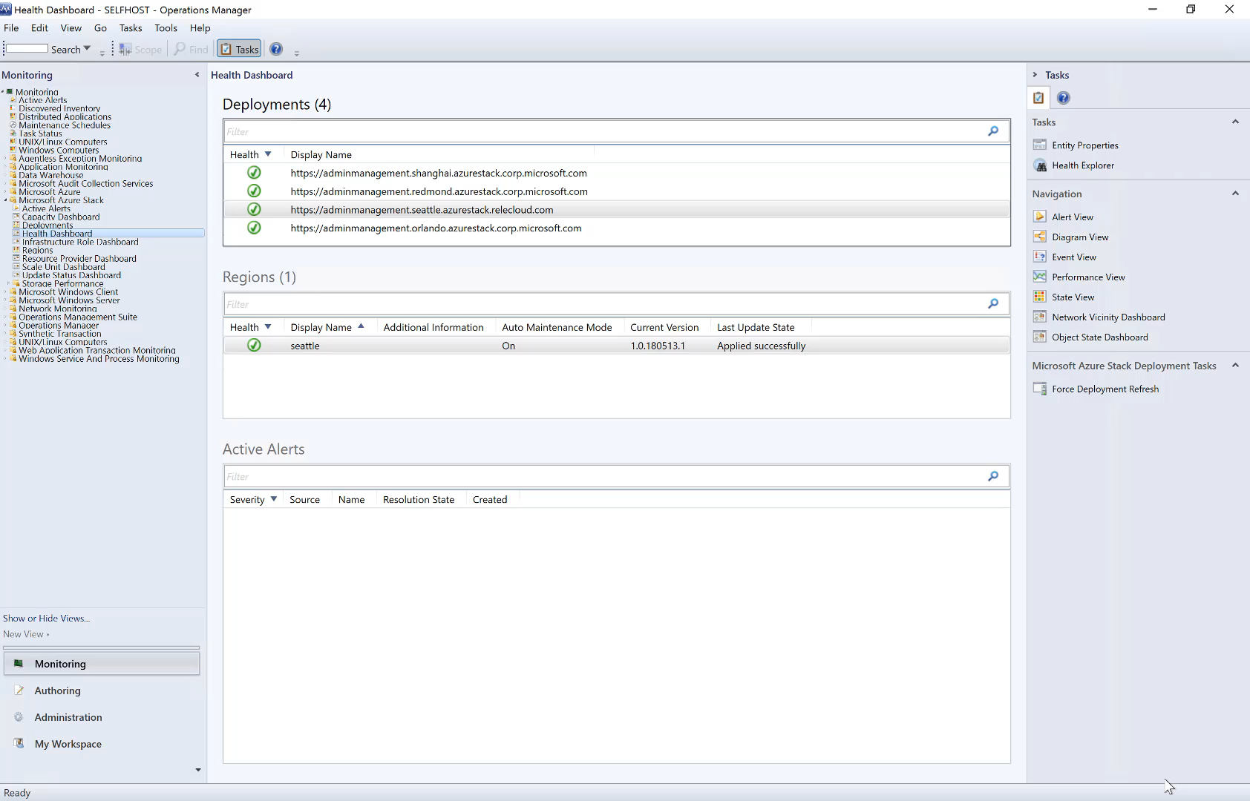

Slide 43
Hardware monitoring and ITSM Integration
Hardware monitoring
Azure Stack Hub will natively surface alerts for Physical Disks, JBODs, and Node failures
All other hardware monitoring will be provided by OEMs using external monitoring tools (SCOM, etc.)
Network Switch monitoring via SNMP
Physical Server monitoring via existing OEM provided agentless monitoring solutions
Implemented on the Hardware Lifecycle Host VM
Enable ITSM by adopting existing pipes
Monitor with existing datacenter monitoring tooling
Use existing connections from monitoring to ticketing systems
Microsoft will provide:
Azure Stack Hub Management Pack for SCOM
Azure Stack Hub Open Source a module for Nagios and support for Nagios Enterprise
Azure Management Pack for Azure Stack Hub Tenant Subscription monitoring using SCOM
API documentation to be used for custom integration

Slide 44
Additional info
Monitoring and updating examples and details:
https://github.com/Azure/AzureStack-Tools/tree/master/Infrastructure
Master list of Azure Stack Hub commands:
https://github.com/Azure/AzureStack-Tools/tree/master/Infrastructure

Slide 45
Health Resource Provider Troubleshooting

Slide 46
Common issues
HRP service cannot access Health storage accounts
Data not flowing to storage accounts from nodes/VMs
HRP services are offline

Slide 47
HRP service cannot access storage accounts
Impact
The monitoring system will not be able to create new alerts, collect telemetry, or update metrics data for specific RP/resource
Data will not be pruned
This issue can occur when storage is down globally or when storage keys were rotated and monitoring system was not updated
Alerts
Administrator will be presented with alerts around storage not available
There may be some already-closed alerts right at setup time. This is a result of some extra-early health assessments while Azure Stack Hub goes through first time setup
Potential resolution
If storage is available for everyone else, try to rotate storage keys
If storage is offline, look for other alerts related to storage

Slide 48
Data not flowing to storage accounts
Impact
Data collected on a host or VM does not leave the OS instance
Once enough time passes the local data will start being overwritten, causing potential loss in monitoring data
Alerts
The monitoring service will notice missing data and display missing host/VM alert
Possible resolutions
This could be caused by an issue in storage or networking. Look for alerts in those areas to understand what is going on

Slide 49
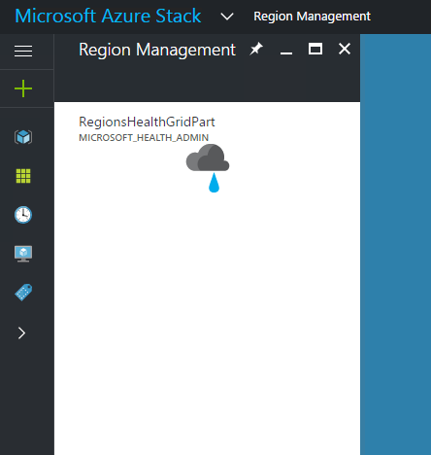
HRP services are offline
Impact
The Administrator UX does not display list of RPs, Resources, or Infra Roles
The affected region is missing in the region list in admin UX
List of regions and region health cannot be retrieved
The SCOM and Nagios integration is broken
Alerts
None, customer must rely on external system
Potential resolution
Restart Health Service Fabric applications – this will require a call to support to get the required access…

Slide 50
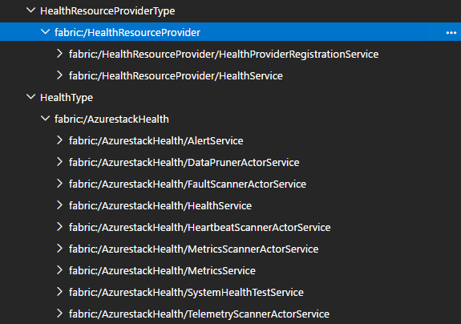
HRP services are offline - Troubleshooting
List of fabric applications…
Support will guide the operations team to get PowerShell access to the Privileged Endpoint
Use PowerShell cmdlets to restart Health SF applications
Use Fabric RP API to restart Health role
If HealthService in either RP or AzurestackHealth is offline the application will appear offline

Slide 51
Getting details from diagnostic data
All components of Monitoring follow the same diagnostics pattern as rest of Azure Stack Hub. Use Get-ASEvent and Get-ASChildEvent cmdlets to filter data.
Event provider names:
Microsoft-AzureStack-Health
Microsoft-AzureStack-Health-WebApi
Microsoft-AzureStack-Common-Infrastructure-Http
You can use common practices developed across the components to get further details from the log data.

Slide 52
Questions?

Slide 54
Azure Stack Hub architecture overview
ARM LAYER
Azure Portal (UX)
Templates/PowerShell/CLI, SDK, etc.
Azure Resource Manager (ARM)
RP LAYER
PARTITION REQUEST BROKER
FRP
SRP
CRP
NRP
HRP
URP
…
INFRASTRUCTURE CONTROL LAYER
Infrastructure Deployment
PHYSICAL
NODE
MANAGEMENT
STORAGE CONTROLLER
COMPUTE CONTROLLER
NETWORK CONTROLLER
INFRA ROLE CONTROLLER
HEALTH CONTROLLER
Bootstrap
Patch & Update
Scale Out
INFRASTRUCTURE ROLES
Workflows
The Azure Stack Hub infrastructure roles are like the task manager in Windows. You know there are things going on, but you don’t need to understand them all, or manage them.
FRU
RESET
Builds
START
STOP
HARDWARE LAYER
NETWORK (SWITCHES)
COMPUTE
STORAGE

Slide 55
Azure Stack Hub architecture overview
ARM LAYER
Azure Portal (UX)
Templates/PowerShell/CLI, SDK, etc.
Azure Resource Manager (ARM)
RP LAYER
PARTITION REQUEST BROKER
FRP
SRP
CRP
NRP
HRP
URP
…
INFRASTRUCTURE CONTROL LAYER
Infrastructure Deployment
PHYSICAL
NODE
MANAGEMENT
STORAGE CONTROLLER
COMPUTE CONTROLLER
NETWORK CONTROLLER
INFRA ROLE CONTROLLER
HEALTH CONTROLLER
Bootstrap
Patch & Update
Scale Out
INFRASTRUCTURE ROLES
Workflows
ACS
NETWORK CONTROLLER
COMPUTE CONTROLLER
HEALTH CONTROLLER
INFRA ROLE CONTROLLER
ARM
UPDATE MGMT
DIRECTORY MGMT
FRU
RESET
STORAGE CONTROLLER
EDGE GATEWAY
You don’t need to know how to manage or troubleshoot these…
INFRA MGMT
CONTROLLER
PARTITION
REQ BROKER
ADFS
Builds
START
LB MUX
PHYSICAL NODE MGMT
INTERNAL DATA STORE
CERTIFICATE MGMT
STOP
INFRA DEPLOYMENT
HARDWARE LAYER
NETWORK (SWITCHES)
COMPUTE
STORAGE

Slide 56
Azure Stack Hub monitoring architecture overview
Azure Resource Manager (ARM)
ARM / Portal Layer
Registration for
Resource Providers
Infra Services
Health RP
Exposes
Health
Alerts
Metrics, log, & security audit storage locations
RP Layer
Fabric Control Layer
OS / Physical Infra layer
Service Fabric Ring
Health Service
Alert Service
Azure Monitoring Agent (MA) collects the following for all Azure Stack Hub SW components:
ETW Events
Metrics
Logs
All data written to RP-specific Storage account with specific containers as shown below
Registration Data
Alert Data
Key concept – monitoring information is placed into a storage account within Azure Stack Hub
Resource Provider’s Storage Account
Alert service generates Alerts based on ETW Events in RP specific storage accounts
Fault Container
Metric Container
Security Container
Diagnostic Container

Slide 57
FRP call flow example – Allocate a VM
ARM LAYER
Azure Portal (UX)
Templates/PowerShell/CLI, SDK, etc.
Azure Resource Manager (ARM)
RP LAYER
PARTITION REQUEST BROKER
FRP
SRP
CRP
NRP
HRP
URP
…
INFRASTRUCTURE CONTROL LAYER
PHYSICAL
NODE
MANAGEMENT
STORAGE CONTROLLER
COMPUTE CONTROLLER
NETWORK CONTROLLER
INFRA ROLE CONTROLLER
HEALTH CONTROLLER
OS LAYER
Windows Server Node/Hyper-V
HARDWARE LAYER
NETWORK (SWITCHES)
COMPUTE
STORAGE

Slide 58
FRP – Physical node management
Interacts with physical servers
Using “PcsvDevice” IPMI implementation
Authenticates using BMC Account or LDAP (Recommended for Larger Scale)
FRP Securely Stores BMC Credentials
FRP
Physical Node Management (PNM)
Power On
Power Off
Power Cycle
Clear Log
Get Log
Set Boot Device
Discovery
Hardware – Base Board Management Controller

Slide 59
FRP – Infrastructure Role Controller
Interacts with Infrastructure Roles (Lifecycle Management)
Windows Auth to interact with Hosting Platform (SF, FC, WS, IIS)
Protocol based on Hosting Platform as well
FRP
Infrastructure Role Controller (IRC)
Role Instance Actions (restart, start, stop)
Patch and Upgrade
Infrastructure Roles / Role Instances

Slide 60
Computer Controller
Interacts with Scale Unit and Hyper-V to manage Virtual Machines
Using PowerShell implementation
Authenticates and authorizes using PowerShell Just-Enough-Admin (JEA)
CRP
FRP
Computer Controller (CC)
VM Placement
VM Actions
VM Configuration
Manage Scale Unit Lifecycle
Scale Units / Hyper-V

Slide 61
Storage Controller
Interacts with Storage Subsystem
Using PowerShell implementation
Authenticates and authorizes using PowerShell Just-Enough-Admin (JEA)
SRP
FRP
Storage Controller (SC)
Pools
Volumes
Shares
SOFS / S2D

